Slide 1



Polarization Drift Compensation for Long Distance Quantum Communication In Optical Fibers
Deven Bowman, Patrick Banner, Deniz Kurdak, Yaxin Li, Trey Porto, Steven Rolston
University of Maryland College Park

Slide 2
Introduction
Long distance quantum communication is key to the future of quantum technologies.
Polarization-encoded photonic qubits are a possible medium for quantum state transportation
Easy to apply rotations
Major problem: polarization drift in optical fibers
Mechanical stresses
Temperature fluctuations
Manufacturing defects

Slide 3
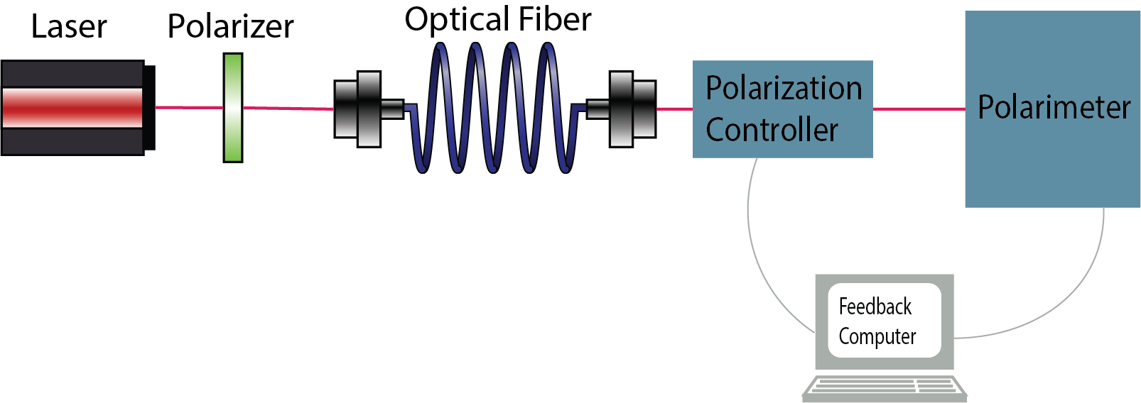
Drift Compensation System: Overview
Our system has 3 major parts: input states, polarization analyzer, and the polarization controller.
I will describe the design/calibration of the polarization analyzer and results of polarization drift measurements.
Notes:
Maybe remove text and enlarge image.

Slide 4
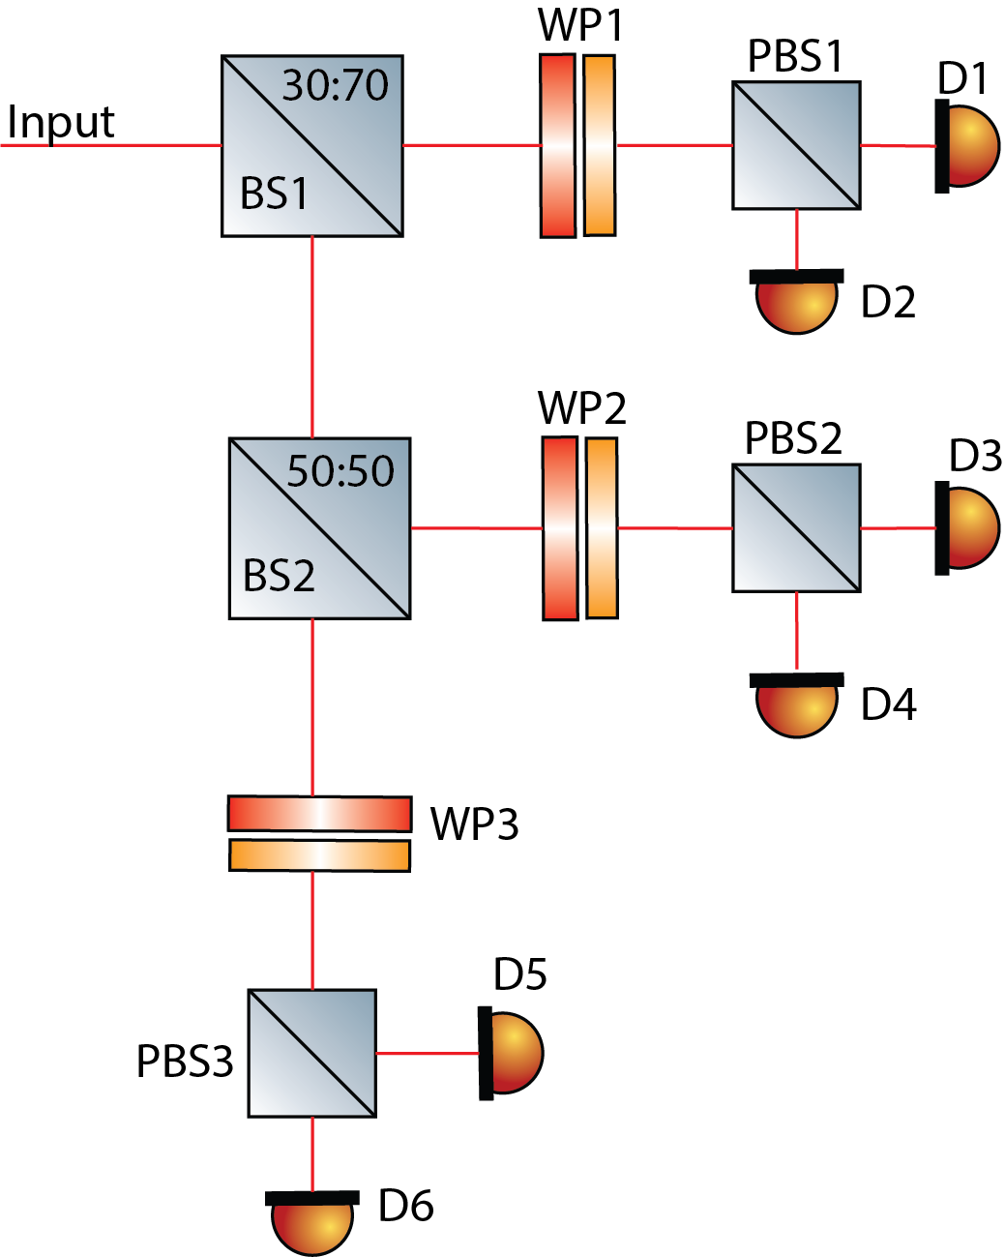
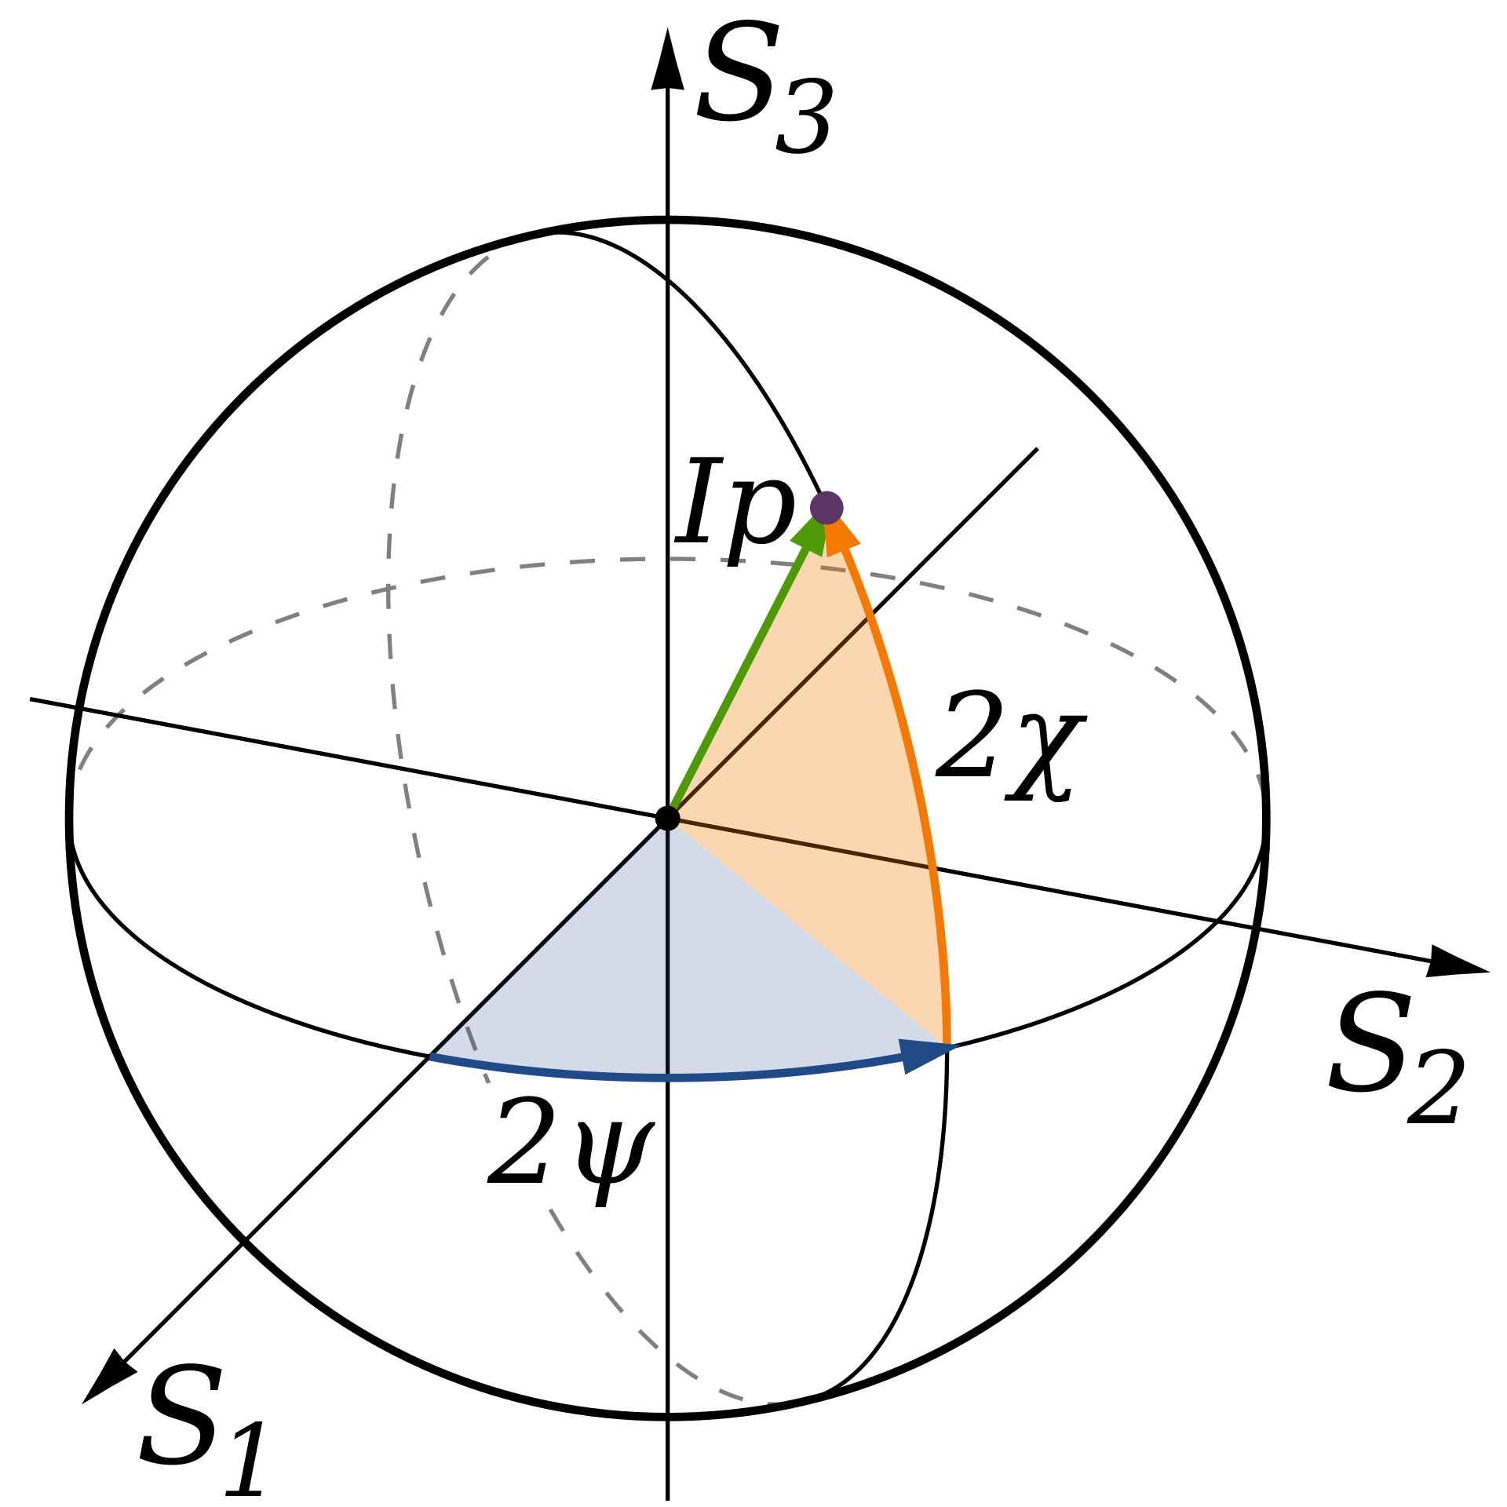
Polarimeter Design
3 detection arms
polarizing beam splitters project H and V components into separate detectors.
preceding waveplates “realign” these projection axes
By Inductiveload - Own work, Public Domain, https://commons.wikimedia.org/w/index.php?curid=4251521
Notes:
Adjust diagram: move bottom arm down and add splitting ratio of BS
Perhaps poincare sphere diagram.
Perhaps less words

Slide 5
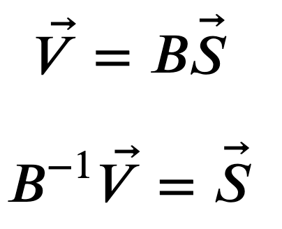
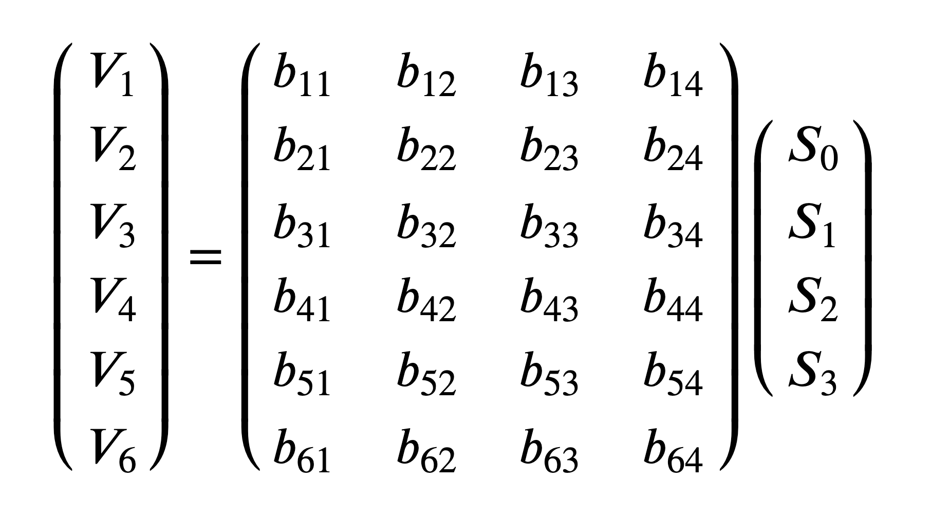
Polarimeter Calibration
Our procedure is based on one presented by Azzam and Lopez, J. Opt. Soc. Am. A(1989).
The measured state is linearly related to the input state.
With the Moore-Penrose inverse of this matrix, we can calculate the input states from measurement.
Notes:
Add stokes param slide.

Slide 6
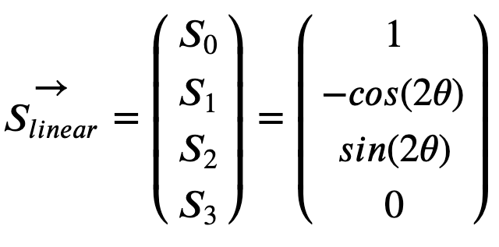
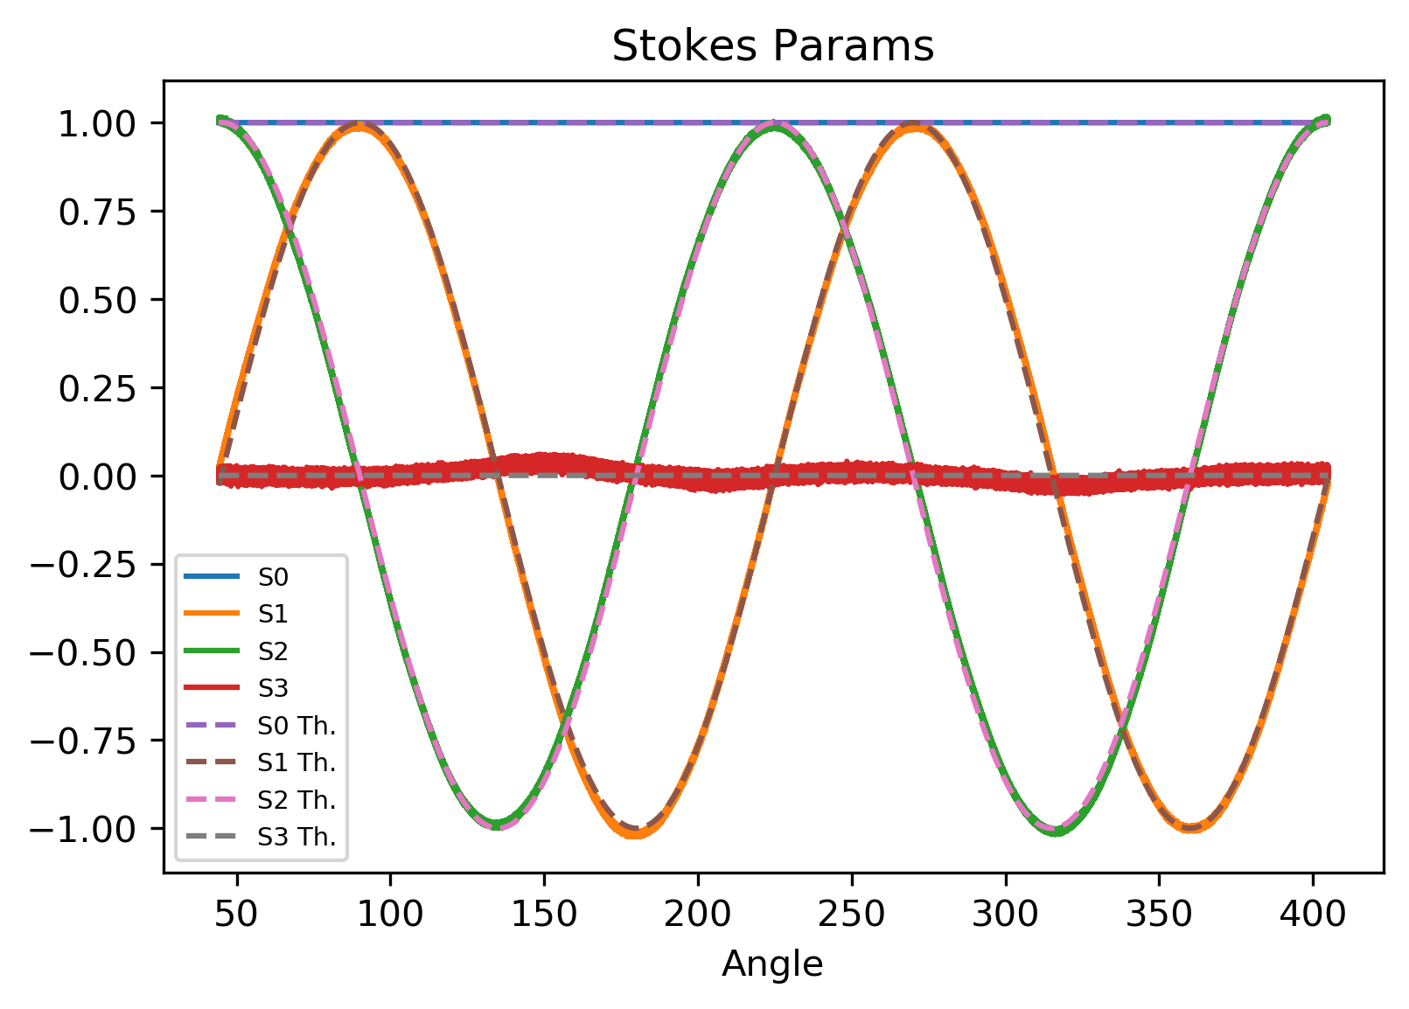
Calibration Data
A linear polarizer on a motorized rotation mount was used to send in calibration states.
theoretical Stokes Parameters(dashed lines), calibrated measurements(solid lines).
Notes:
Decrease text and move equation

Slide 7
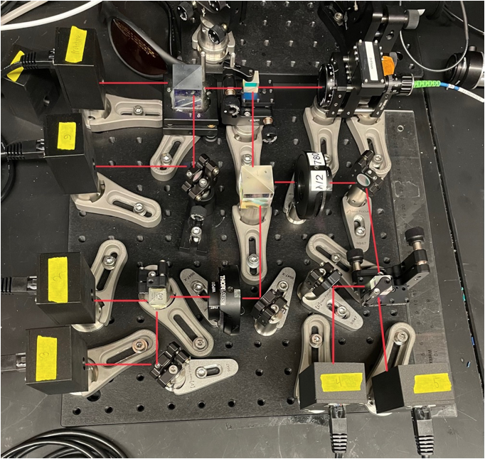
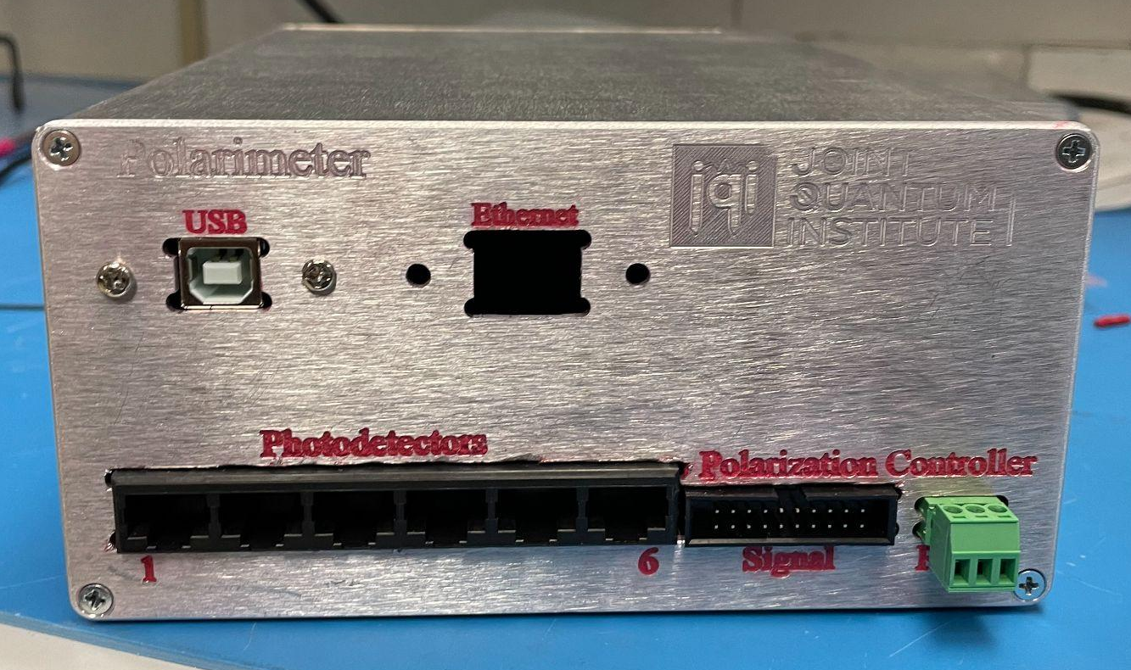
Polarimeter System
Notes:
Combine with following slide and make more concise. Make read lines bold

Slide 8
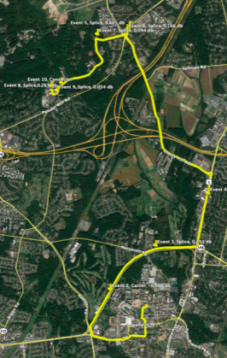
University of Maryland to Army Research Labs fiber link
UMD and ARL are connected by 2 ~13km fiber optic cables. They are connected on the ARL side for a ~26km fiber loop.
This fiber provides an optimal test bed for our system.
Measurements were taken to measure the polarization drift in this fiber. Several other preliminary measurements were conducted for comparison.
A constant polarization state was launched into the fiber and the polarization was measured on the output by the polarimeter.
Notes:
Trim words

Slide 9
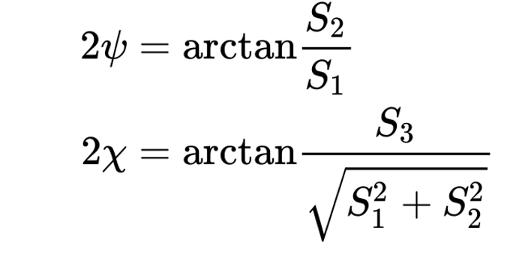
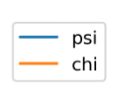
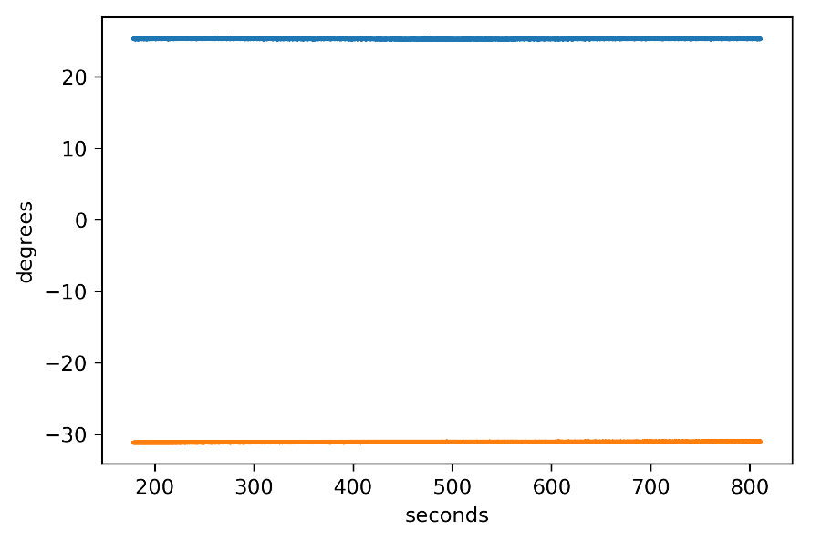
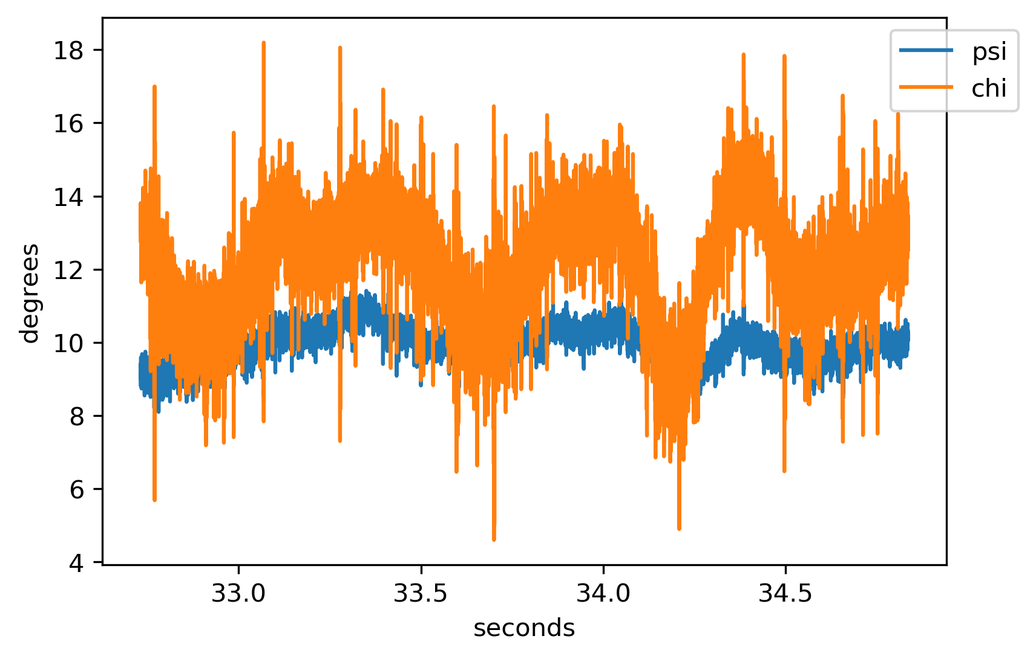
Polarization Drift Traces
Direct Connection
26km UMD-ARL Fiber
Notes:
Trim words

Slide 10
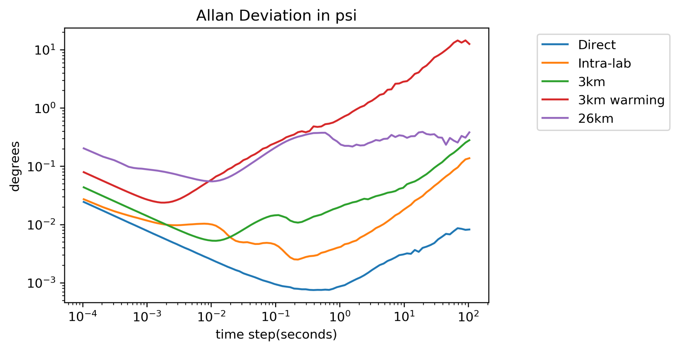
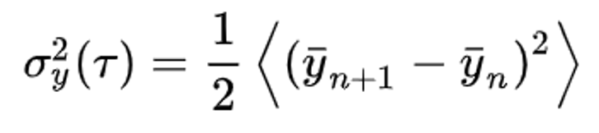
Drift Speed Analysis
An Allan Deviation analysis was conducted.
Standard deviation between averages over windows of duration 𝛕.
Notes:
Don’t try to explain all the lines or to explain allan deviation too technically.

Slide 11
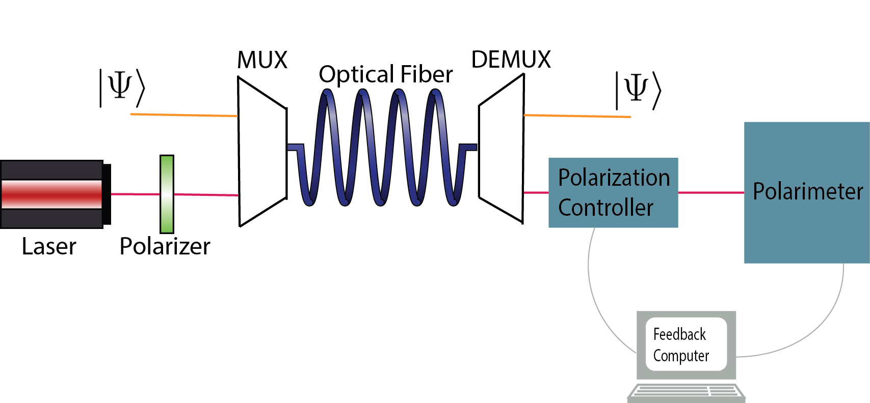
Going Forward
Polarization controller feedback algorithm
Integrate the drift compensation system into a quantum
Wavelength Division Multiplexing
Polarization Mode Dispersion measurements
Notes:
Possible a WDM graph?

